Slide 1
Preparing for university
NGA
sixth form

Slide 2
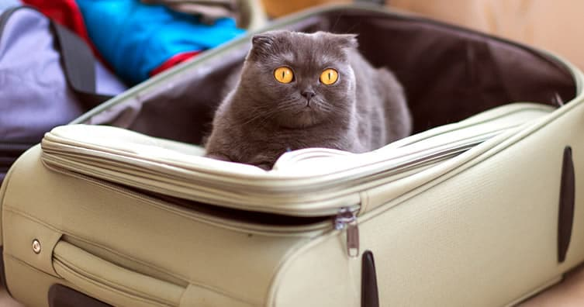
What to take with you if you’re moving
If you visit the ‘save the student’ website link, you will see lots of great advice on what to take with you to university.
Each category listed below is broken down further so you have a comprehensive list:
Important documents
Electricals
Kitchen utensils
Bedroom items
Bathroom products
Clothing
Stationery
Miscellaneous
Save the student
NGA
sixth form

Slide 3
But remember… you are not moving to the moon!
NGA
sixth form

Slide 4
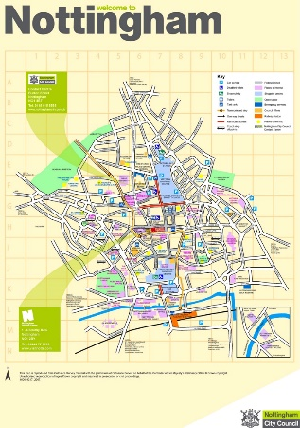
Get to know the local area
If you are moving to a new area, or even into student halls here in Nottingham, it is good to familiarise yourself with the local area.
Even though we are in a lockdown and physical visits aren’t possible, you can still access virtual tours of the university grounds on their websites to get a feel of what they offer.
Find out the local bus routes, tram or train times so you know how to travel back home. Sometimes students don’t realise how close or far an area is! Could you invest in a bike to cycle from your halls and around campus?
Where is your local shop or gym? Lots of accommodation offer a gym on site which can be included in your rent costs.
If you are carrying out placements, where will you need to travel to and how will you get there?
What does the local area offer? Is there a park nearby or other places of interest you can visit?
Remember to stay safe – Try to travel with friends, especially at night time. Lots of universities have 24hour security. Make sure you know the contact details for them in case you need it or contact 999 if you need to.
NGA
sixth form

Slide 5
Budgeting
There is a lot of information online about how to budget including different apps and spreadsheets you can use to track and monitor your spending.
It can be very exciting having large amounts of money going into you bank account that you may never have had before. It is tempting to spend, spend, spend, but it is essential you are sensible with your money as often it needs to last you for over a term at a time.
The money saving expert website and the UCAS website have lots of useful tips for you to follow and learn from…check out the links below.
Money Saving Expert
UCAS finance tips
NGA
sixth form

Slide 6
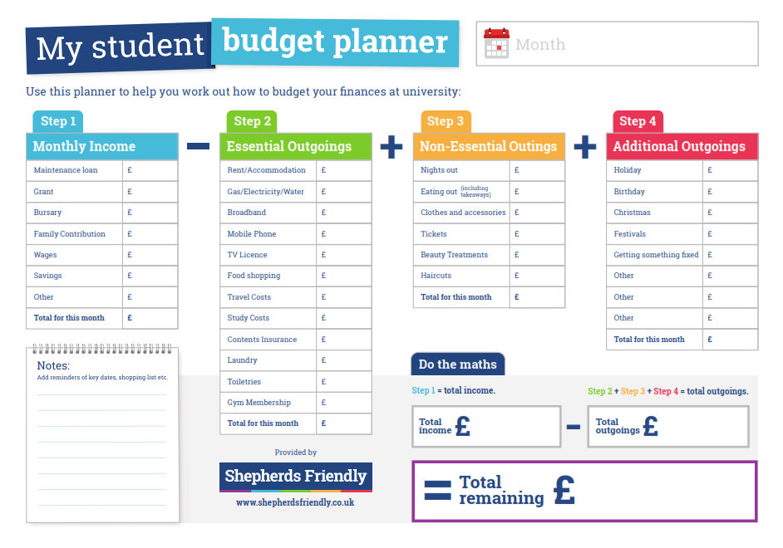
Tips
Try to budget your money – use a budget planner to help you.
Start with essentials.
It can be tempting to buy a new top or pair of shoes but make sure your living costs such as rent and food bills have been paid first!
NGA
sixth form

Slide 7
Student gadgets
According to Endsleigh Insurance, 96% of students take a laptop to university with them, while almost one in four have their own iPad. However you should be able to manage without your own laptop or other tech by using university computers and printers, but having your own can make life easier. If you don’t have a laptop and are worried about this you could try the first few weeks without one and then prioritise getting on with your student loan/grant once the terms starts if you find you need one.
You may wish to check out the IT provision at your university or see what fellow students have bought to get some ideas.
Don’t forget if you are taking high cost items to uni (mobile/TV/Laptop) you should look at insurance to protect your belongings.
Endsleigh insurance
Go Compare
NGA
sixth form

Slide 8
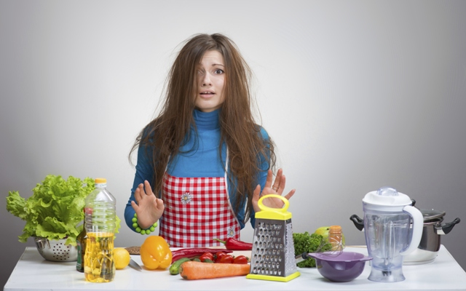
Cooking
Again, it can be tempting to eat out at the local takeaways, but not only is this
not the most healthy choice it tends to be much more expensive!
You are likely to share accommodation – you could buy food with your flat/house mates
and cook together or share the cost of regular use items like milk/sauces/bread etc.
Batch cooking – When you are cooking, make enough for another meal and save in the fridge or freezer.
Use the links below to get some ideas of recipes.
You could practice your culinary skills during lockdown!
Meals to cook at Uni
BBC Good Food – Student Guide
Olive - student recipes
NGA
sixth form

Slide 9
Get connected via social media with your university
Follow your university's official Instagram, Twitter and other social media accounts to get in the mood for becoming a member of their institution. Doing this can make you feel a part of the community before starting/arriving.
You will get access to important updates and news ahead of freshers' week, when so much is happening. Your university may have several different society groups too (check these out…joining a society at university is AMAZING, for making friends with other with similar interests and having something fun to do alongside studying!) You could also use this as an opportunity to ask current students any questions you might have prior to starting.
The links also give you advice on how to stay safe online during your time at university!
Uni Guide Safety
Freshers week
NGA
sixth form

Slide 10
Get reading!
Many universities put their reading lists online weeks before their courses begin or will send you information about reading which may be useful preparation.
We have also provided a PIXL6 resource that will support with this featuring useful things to read/do to prepare for a variety of courses. Year 13 - Supporting Your Progression to University Booklet.docx
Reading can give you useful insight into what to expect in relation to your course content and can increase your confidence before attending your first classes.
You don’t need to buy or read everything, some reading is better than none!
NGA
sixth form

Slide 11
Things our previous students have said…
‘I’ve moved into my university halls (been 2 weeks thus far), at first it was difficult to adjust what with being in a new city and not knowing anyone but things are much better now.’
‘I’ve settled in and know all my flatmates and know the majority of places now.’
‘I am enjoying my course so far but there’s so much reading to do it’s a little scary. It was also surprisingly easy to make friends with people, which I didn’t expect but was a nice surprise.’
‘Living independently is ok. It’s hard at first but it’s ok now I’ve adjusted. I have a list of societies I am looking into joining, I remember you saying this is something we should all do!’
NGA
sixth form

Slide 12
Things our previous students have said…
‘At first I forgot to get mugs, plates, forks etc. because I thought I wouldn’t need to seeing as am in catered accommodation! I’ve been shopping now!’
‘I also forgot about grocery shopping but am on top of that too now, you forget things like that because usually they’re readily available at home.’
‘I think I might need one more week to be completely adjusted but it’s going ok!’
NGA
sixth form

Slide 13
Things our previous students have said…
‘I know it's a bit of a random email, but I felt like it deserved to be sent. Whilst being at Sixth Form I really did not know if continuing my education was going to be something I enjoyed or even wanted to do, it was just something I did to fill my time and give my life some sort of routine, but now that I'm three days away from completing my first year at uni and should hopefully come out with a 2:1 if not, a first :) it made me realise that the help and support I received at Sixth Form was a huge one and it's probably the only reason I decided to go and even apply to university. I wouldn't have ended up at the University of Lincoln and meeting all the wonderful people I've met and gone on to do fun and worthwhile things this year if it wasn't for the fact that you pointed out it was good for technology or studying computer science, so I mainly just wanted to thank you for that.
I also wanted to thank all my teachers for all the help they gave me, I may not have realised it straight away at the time, but I sure do appreciate it all, from all the extra help in the half term, to getting my emails replied not soon after I sent them, even if it was stupidly late at night.
The point of this email is mainly to just say thank you, and my other A-Level teachers and mainly for that bit of normality and stability that being at Sixth Form brought to my life. I feel like it is something that goes by under appreciated and it's only when you look back on things that you realise. To say I was someone who originally didn’t like education, I love it now that I'm at university. I can only hope the current A-level students appreciate Sixth Form as much as I do, even if I did sometimes get kicked off the common room sofas ha ha!’
NGA
sixth form

Slide 14
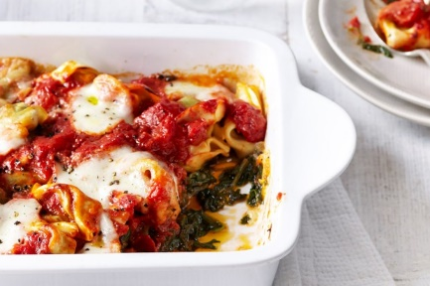
Challenges – get involved!
Cook a budget friendly university meal and send us a picture in Teams!
Come up with a spreadsheet/layout for budgeting
Let us know about 1-3 societies you have looked up at university
Add a sentence or two about why this society appeals to you!
Find out some fun facts about your university:
Have celebrities studied there?
What unique information can you find about the university – Historical information? Does it host any well known annual events such as Sport or Music? Has the campus been used in any films or music videos?
NGA
sixth form

